Slide 1
New Proposal Network Traffic Analysis Private Network Health Assessment
China unicom
JiaHui Liu（Speaker）email: liujh502@chinaunicom.cn
Liu He email: hel200@chinaunicom.cn

Slide 2

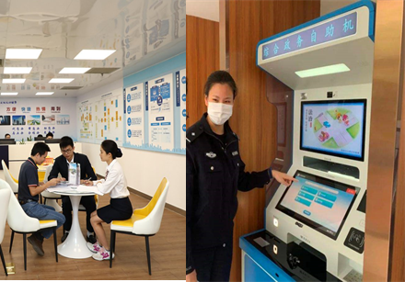


Network Traffic Analysis-Background
To meet the demand of 5G private network customers for network performance monitoring, the API provides business traffic statistics to enable real-time monitoring and analysis of 5G private network performance.
High-Priority Application Assurance: Analyze the traffic data of 5G private network users to identify high-traffic applications within the network, focusing on ensuring the smooth operation of specific users and applications, thereby guaranteeing the smooth running of high-priority services.
Business Quality Analysis: Analyze traffic data over time to determine if there are any anomalies in service traffic, providing auxiliary analysis and judgments for potential network failures and quality degradation.
Network Security Monitoring: Monitor traffic patterns to identify and detect abnormal traffic activities, issuing warnings for potential malicious activities, such as DDoS attacks or internal data breaches.
Education Dedicated Network
Government Dedicated Network
Low-Altitude Dedicated Network
Maritime Dedicated Network
Online Education Quality Monitoring
Monitoring the traffic data of the 5G education private network allows for real-time understanding of the smoothness of online classes
Monitor the traffic of the government-specific network
Prevent and detect network attacks and data breaches targeting government systems.
Remote Control/Environmental Sensing
Ensure stable and reliable data transmission for drones during missions such as agricultural monitoring and disaster assessment.
Maritime communication assurance
Monitor the 5G communication traffic of maritime operations (such as ships and drilling platforms) to ensure the stability of communication links and the real-time nature of data transmission.

Slide 3
Network Traffic Analysis-API Definition
API Name | Network Traffic Analysis API
Description | Provide business traffic statistics for 5G private network customers, which can be used for monitoring and analyzing the performance of 5G private networks.
Input Parameters | Service Time: Start Time ~ End Time (Optional)
 | Query Interval: Traffic Analysis Time Granularity (Optional)
 | Application ID: Specific Business ID for Query (Optional)
Return Results | Business Access Count Business Upstream and Downstream Traffic Business Address Business Name

Slide 4
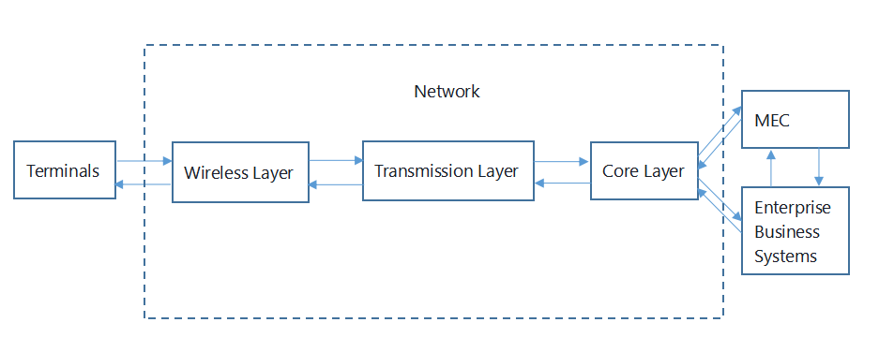

Private Network Health Assessment-Background
The private network encompasses traditional telecommunications networks such as wireless networks, transmission networks, and core networks. It also includes a variety of client-side and business-side network element devices, such as terminals, IoT cards, and MEC edge clouds. From the perspective of customer management, the management of a 5G private network needs to extend from the network side to the client and business sides, requiring unified and centralized management of all involved network element devices. However, what we primarily propose here is how to define the health analysis of the network layer.

Slide 5
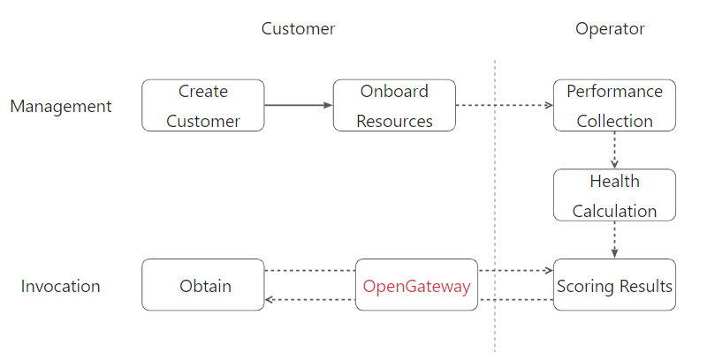
Private Network Health Assessment-API Definition
1.Introduction to Business Process
2.API Info
Interface name | Private Network Health Assessment
API Description | User Inquiry for Private Network Health Score: The 5G private network consists of multiple components such as the wireless network, transmission network, and core network. By calculating the health score for each section and then applying weighted computation, the comprehensive health score for the 5G private network is determined.
Request Parameters | Health Module: The network module for which the health score needs to be queried, with optional values including: net (whole network) net_wireless (wireless network) net_transnet (transmission network) net_core (core network).
Response Parameters | Health Score Report Generation Time

Slide 6
Thank you

